Slide 1
May Howard Elementary PTA
General Meeting Agenda
March 8, 2022
Welcome by Meg Adams, PTA President
Approval of General Meeting Minutes from March 8, 2022
Approval of Agenda by M. Adams
Principal’s Message
Treasurer’s Report by Angela Schreiber, Treasurer
Appointment of Nominating Committee by M. Adams
PTA Programs Update by Catherine Growe, VP Programs
Information from School Board Representative Shawn Kachmar
New Business
Set Next Meeting & Adjournment by M. Adams

Slide 2
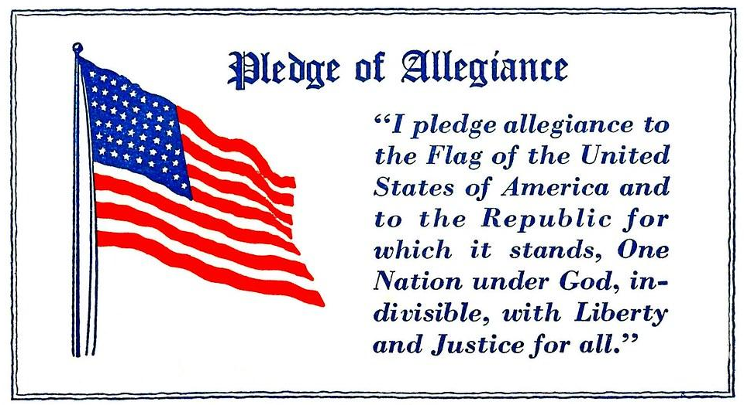
Welcome!
Call to Order
Please Rise for the Pledge of Allegiance
Introduction of special guest, our SCCPSS District 4 Board Representative Shawn Kachmar
Back To Agenda
Next Agenda Item

Slide 3
Approval of September 14, 2022 General Meeting Minutes
LINK TO MEETING MINUTES
Do I have a motion to approve?
Do I have a second?
All in favor of approving tonight’s agenda please respond Aye.
All opposed to approving tonight’s agenda please respond Nay.
Return to Welcome
Next Agenda Item

Slide 4
Approval of Agenda
Do I have a motion to approve?
Do I have a second?
All in favor of approving tonight’s agenda please respond Aye.
All opposed to approving tonight’s agenda please respond Nay.
Back To Agenda
Next Agenda Item

Slide 5
A Message from Principal Taylor
Back To Agenda
Next Agenda Item

Slide 6
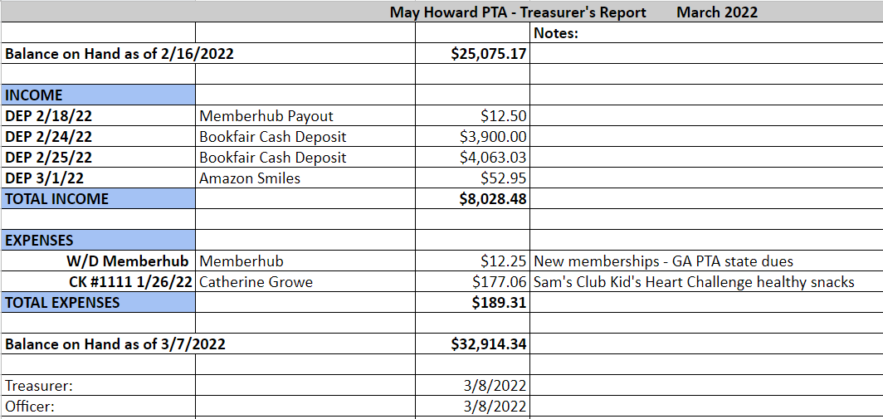
Treasurer’s Report as of March 8, 2022
Back To Agenda
Next Agenda Item

Slide 7
Appointment of Nominating Committee
It is time to gather nominees for the 2022/2023 May Howard Elementary PTA. Any and all PTA members are encouraged to consider and inquire about joining the PTA board. Current PTA board members are available and more than happy to answer questions!
First, our PTA Secretary Christelle Gionavinni will read our bylaws pertaining to the nomination and election of officers.
Do we have any volunteers?
Do I have a motion to approve the 5 volunteers and 1 alternate to be on our Nominating Committee?
Do I have a second to this motion? All in favor please say Aye.. All Opposed please say Nay.
Back To Agenda
Next Agenda Item

Slide 8
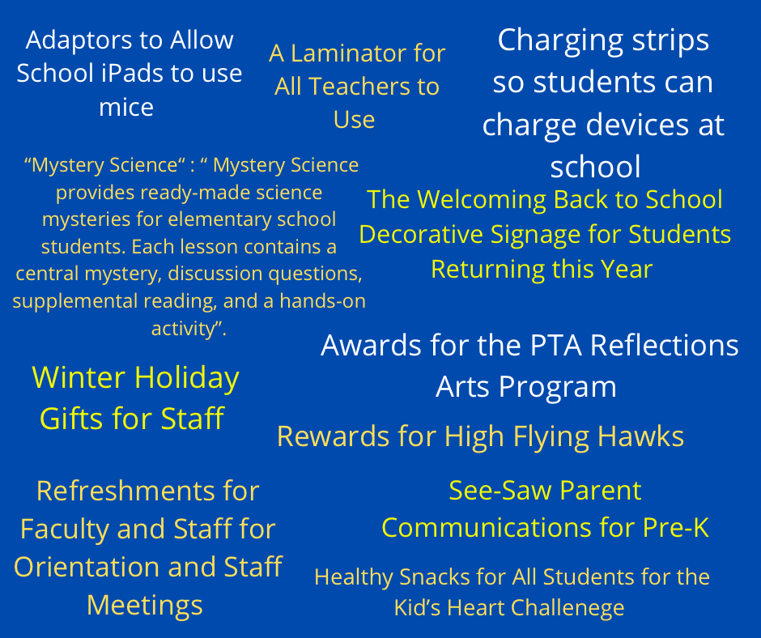
PTA Programs Update
Programs & Related Products Funded by PTA this Year
Spirit Nights for May Howard
March 22nd - Molly McGuire’s
April 6th - Papa Murphy’s
Teacher Appreciation Week
May 2nd - 6th
School Supply Kits Offered
Back To Agenda
Next Agenda Item

Slide 9
Information and Updates from Our SCCPSS District 4 Representative, Shawn Kachmar
Back To Agenda
Next Agenda Item

Slide 10
New Business
Back To Agenda
Next Agenda Item

Slide 11
Next PTA General Meeting:
April 12, 2022 @ 6:00pm
Do I have a motion to adjourn the PTA meeting and begin Curriculum Night?
Do I have a second?
All in favor of adjourning please respond Aye.
All opposed to adjourning please respond Nay.
Back To Agenda

