Slide 1
May Howard Elementary PTA
General Meeting Agenda
September 14, 2021
Welcome by Meg Adams, PTA President
Approval of Agenda by Meg Adams
Principal’s Message
Consideration of Budget by Angela Schreiber, Treasurer
Approval of Budget by Angela Schreiber
Consideration of Calendar by Meg Adams, President
Approval of Calendar by Meg Adams
Information Regarding PTA Programs by Catherine Growe, VP Programs
Information from School Board Representative Shawn Kachmar
New Business
Set Next Meeting & Adjournment for Curriculum Night by Meg Adams

Slide 2
Welcome!
Call to Order
Please Rise for the Pledge of Allegiance
Introduction of PTA Executive Board Members
Introduction of special guest, our SCCPSS District 4 Board Representative Shawn Kachmar
Back To Agenda
Next Agenda Item

Slide 3
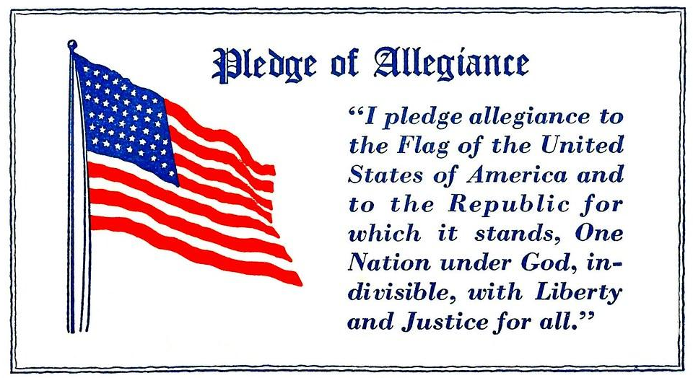
Return to Welcome

Slide 4
2021/ 2022 May Howard PTA Executive Board Members
Meg Adams, President
Catherine Growe, VP of Programs
Joseph Toole, VP of Membership
Angela Schreiber, Treasurer
Christelle Giovannini, Secretary
Return to Welcome
Next Agenda Item

Slide 5
Approval of Agenda
Do I have a motion to approve?
Do I have a second?
All in favor of approving tonight’s agenda please respond Aye.
All opposed to approving tonight’s agenda please respond Nay.
Back To Agenda
Next Agenda Item

Slide 6
A Message from Principal Taylor
Back To Agenda
Next Agenda Item

Slide 7
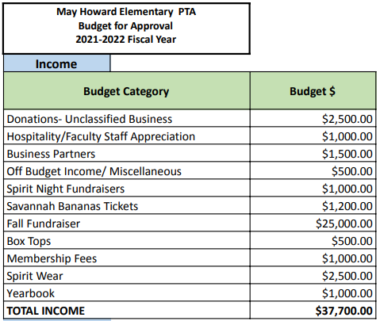
Proposed Budget -
Income
To Proposed Expenses

Slide 8
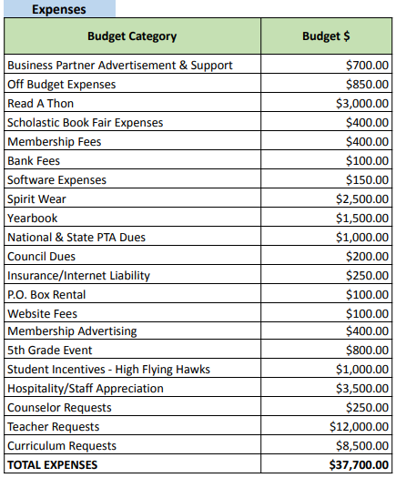
Proposed Budget -
Expenses
Back To Agenda
Next Agenda Item

Slide 9
Approval of Budget
Do I have a motion to approve the budget?
Do I have a second?
All in favor of approving the budget for the 2021 – 2022 fiscal year please respond Aye.
All opposed to approving the budget for the 2021 – 2022 fiscal year please respond Nay.
Back To Agenda
Next Agenda Item

Slide 10
Proposed Calendar
All dates and times are tentative.
Back To Agenda
Next Agenda Item

Slide 11
Approval of Calendar
Do I have a motion to approve the calendar (with dates tentative)?
Do I have a second?
All in favor of approving the calendar for the 2021 – 2022 school year please respond Aye.
All opposed to approving the calendar for the 2021 – 2022 fiscal year please respond Nay.
Back To Agenda
Next Agenda Item

Slide 12
PTA Programs Update
Spirit Nights for May Howard
Savannah Bananas was a success! We raised over $1,200
Spirit Wear - Arriving this week!
September 21st - Molly McGuire’s
October 20th - Papa Murphy’s
Committees Update
Business Partners Needed
How to Help Raise $

Slide 13
Ways to Earn Money for May Howard
Publix Partners
Boxtops for Education
Amazon Smile
Back To Agenda
Next Agenda Item

Slide 14
Information and Updates from Our SCCPSS District 4 Representative, Shawn Kachmar
Back To Agenda
Next Agenda Item

Slide 15
Next PTA General Meeting:
December 14, 2021 @ 6:00pm
Do I have a motion to adjourn the PTA meeting and begin Curriculum Night?
Do I have a second?
All in favor of adjourning please respond Aye.
All opposed to adjourning please respond Nay.
Back To Agenda

